Slide 1
BIRCH Balanced Iterative Reducing and Clustering using Hierarchies An Agglomerative Hierarchical Clustering Algorithm Tian Zhang, Raghu Ramakrishnan, Miron Livny
Presented by: Milad Hasani

Slide 2
Motivation
Major weakness of agglomerative clustering methods
Do not scale well; time complexity of at least O(n²), where n is total number of objects
Can never undo what was done previously
Birch: Balanced Iterative Reducing and Clustering using Hierarchies
Incrementally construct a CF (Clustering Feature) tree, a hierarchical data structure summarizing cluster info; finds a good clustering with a single scan
Apply multi-phase clustering; improves quality with a few additional scans

Slide 3
Introducing BIRCH
Stands for: Balanced Iterative Reducing and Clustering using Hierarchies
Designed for very large datasets
Scans each data only once and runs in O(n)
Incremental and dynamic clustering of objects
It makes full use of available memory to derive the finest possible sub-clusters while minimizing I/O costs.
Does not need the whole data in advance
KEY Phrases:
Scans the database to create an in-memory Tree known as CF-Tree
Applies a known agglomerative clustering algorithm to cluster leaves

Slide 4
How it works
BIRCH operates in four phases.
First Phase: Building the height balanced CF-Tree
Second Phase(optional in original presentation): Rescanning the leaves in order to create a smaller tree, while removing the outlier datas and grouping crowded clusters into larger ones.
Third Phase: Apply an existing clustering algorithm in order to cluster the leaves of CF Tree only by CF Values. (agglomerative hierarchical clustering algorithm is applied in the original presentation)
Forth Phase: Refining, Redistribute the data In clusters by using the centroids calculated in phase 3 in order to obtain a new set of clusters.

Slide 5

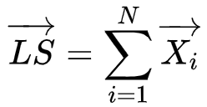
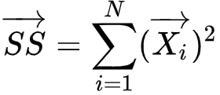
What is CF ?
Stands for Cluster Features
N = Number of entries in the cluster/subcluster
LS = Linear Sum of data points
SS = Squared Sum of data points
All of the required calculations can be done using CF without knowing the actual underlying values.

Slide 6
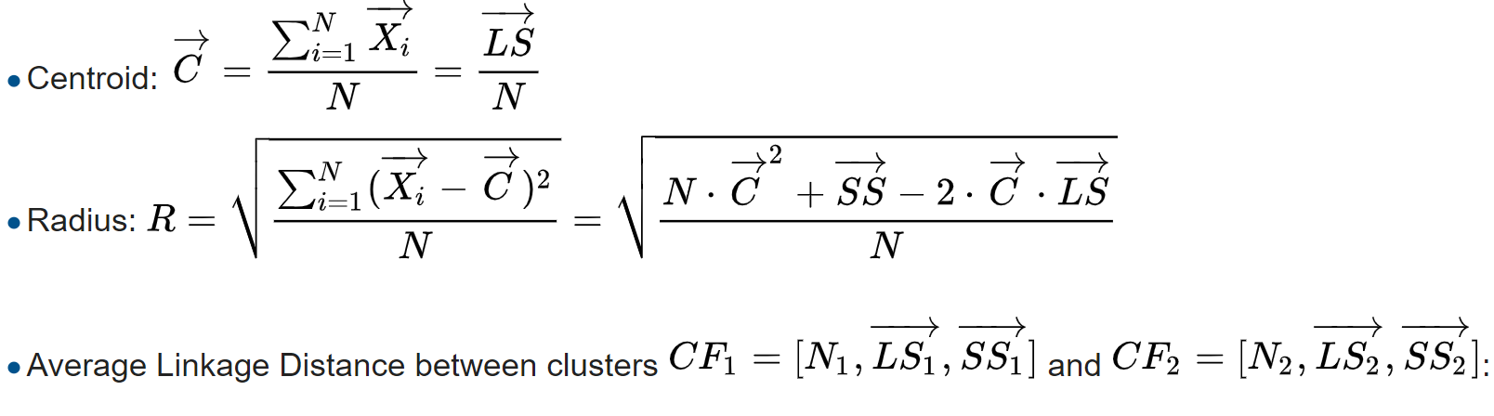
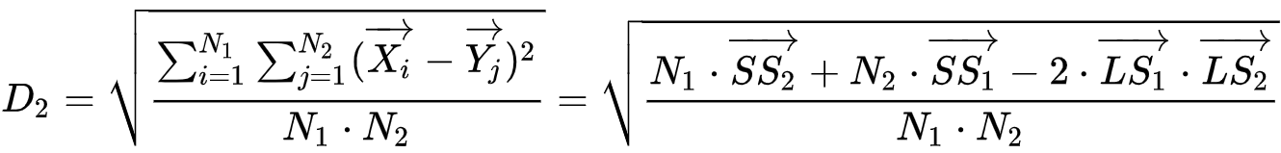
What is CF ?
Given only the CF Vector, these measures can be calculated without knowing the actual underlying values.

Slide 7
Why CF is all we need

Slide 8
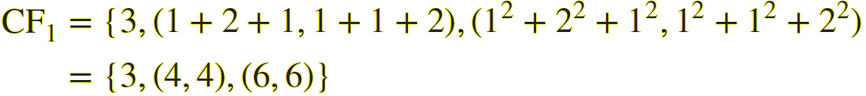
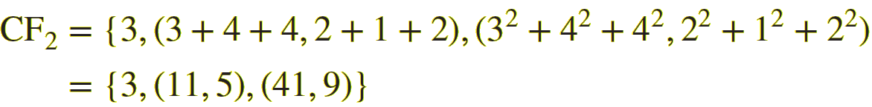
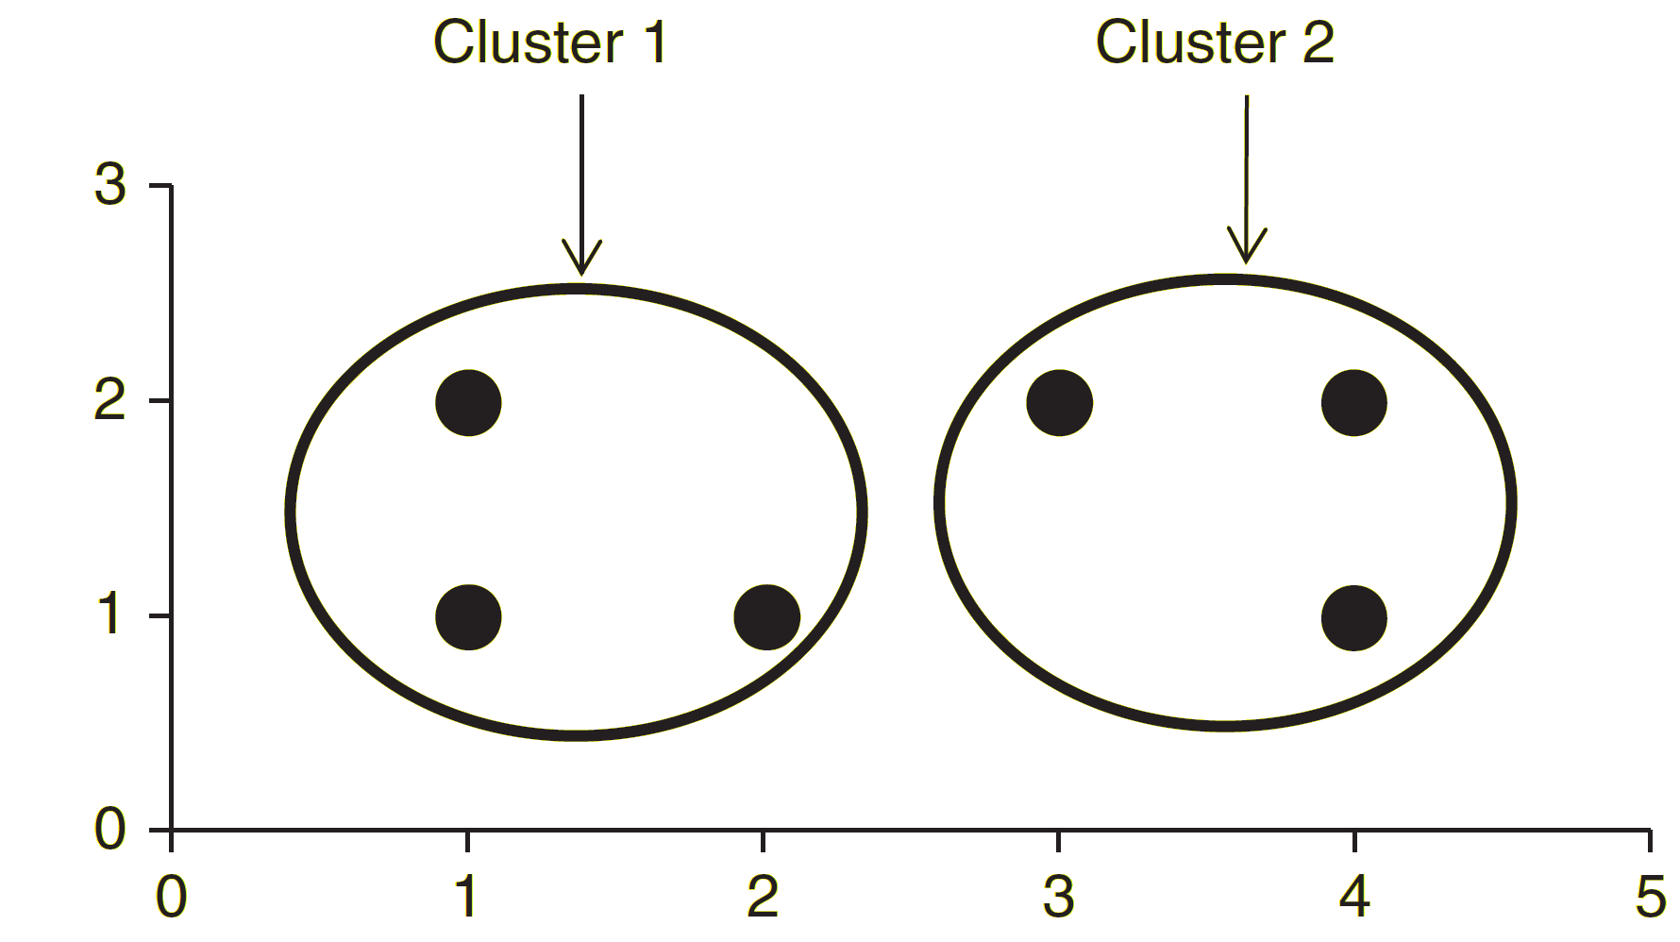
CF calculation example
Consider Cluster 1 containing values (1,1), (2,1), (1,2), whereas Cluster 2 containing (3,2), (4,1), (4,2).
CF12 = CF1 + CF2

Slide 9
CF of merged clusters
One mechanism of the BIRCH algorithm calls for the merging of clusters under certain conditions. The Additivity Theorem states that the CFs for two clusters may be merged simply by adding the items in their respective CF trees. Thus, if we needed to merge clusters 1 and 2, the resulting CF would be :
CF12 = CF1 + CF2

Slide 10
Cluster Feature Tree
A CF Tree is a tree structured composed of CFs. A CF tree represents a compressed form of the data, preserving any clustering structure in the data. A CF tree has the following parameters:
Branching Factor B: Determines the maximum children allowed for a non-leaf node.
Threshold T: T is an upper limit to the radius of
a cluster in a leaf node.
Number of Entries in a Leaf Node L

Slide 11
Phase 1: Building the CF Tree
Each data is treated as a subcluster therefore CF is calculated for it.
Start from root, traverse down tree to choose closest leaf node for d
Search for closest entry L_{i} in leaf node
If d can be inserted in L_{i}, then update CF vector of L_{i}
Else if node has space to insert new entry, insert; else split node
Once inserted, update nodes along path to the root; if there is splitting, need to insert new entry in parent node (which may result in further splitting)

Slide 12
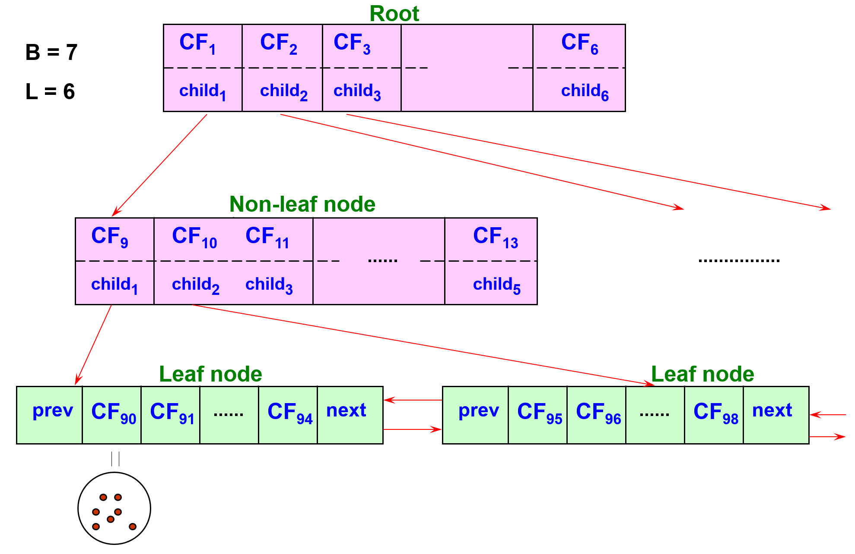
Example of a CF Tree

Slide 13
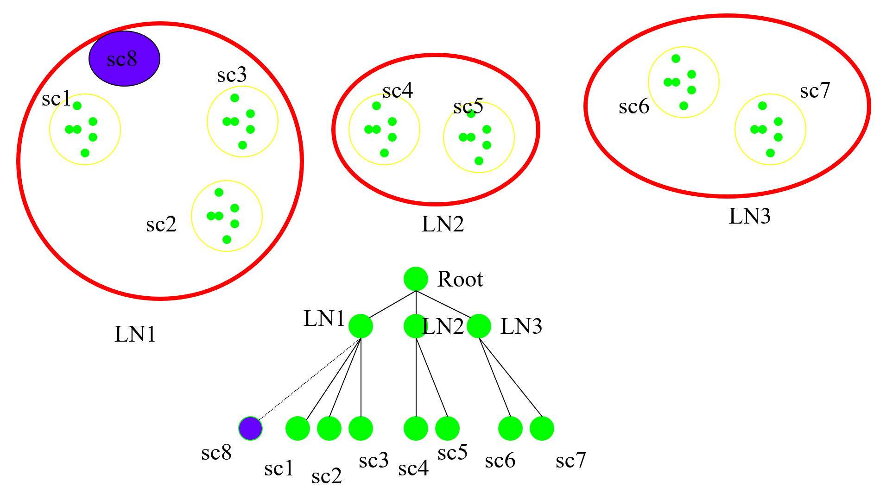
Clarifying B and L

Slide 14
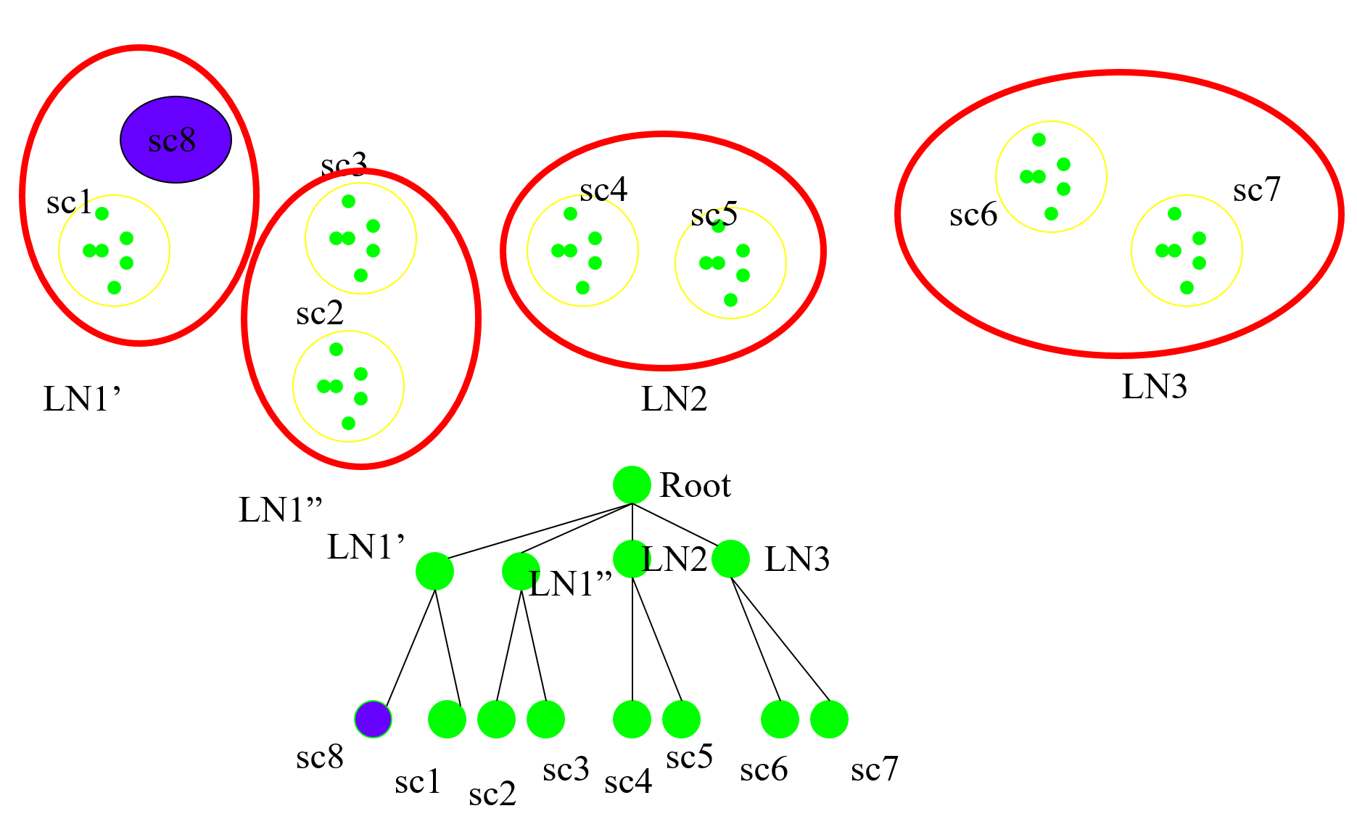
Merge Operation
If the branching factor of a leaf node can not exceed 3
, then LN1 is split.

Slide 15
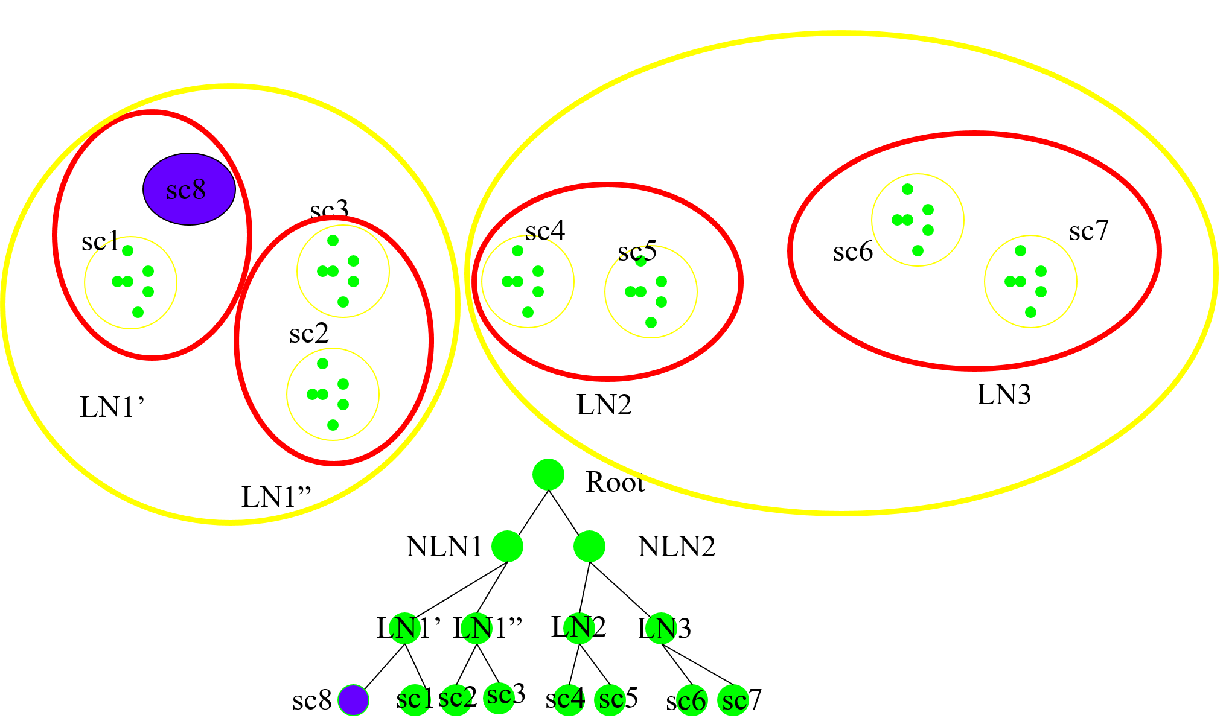
Merge Operation
If the branching factor of a non-leaf node can not exceed 3, then the root is split and the height of the CF Tree increases by one.

Slide 16
Important notes about BIRCH
Order Dependency: Incremental clustering algorithm such as BIRCH suffers order dependence. CURE uses a similar approach to BIRCH’s CF Tree: each cluster is represented by a certain number of “well scattered” points. CURE relies on drawing random samples from the dataset to derive starting clusters.
Threshold Heuristics:
Since rebuilding the CF tree is generally fast enough to allow an iterative approximation to a “Best” suitable threshold. All performance analysis in the original paper start with T=0 and the authors note that beginning with a good initial value for T would save about 10% time. BIRCH maintains a record of leaf radii as a function of the number of points in the cluster. Using lease squares regression it can estimate to future growth of the tree, and extrapolate an “expansion factor”, which will generally be higher for high-volume trees.

Slide 17
Important notes about BIRCH
The authors of STING employ similar techniques and claim to have outperformed BIRCH by a large margin.
Non-Spherical: BIRCH uses the concepts of radius and diameter to control the boundry of a cluster. This approach may not work well when clusters are not spherical, because clustering is limited to a vector space. BUBBLE allows single-pass Scalable clustering in arbitrary metric spaces based on the BIRCH framework.
Low dimensionality, Agrawal et Al. tested three algorithms on a dataset with varying dimensionality from 5 to 50 dimensions. At more that five dimensions BIRCH was unable to identify the true clusters. Since it gives equal importance to all of the dimensions when computing the distance between two points.

Slide 18
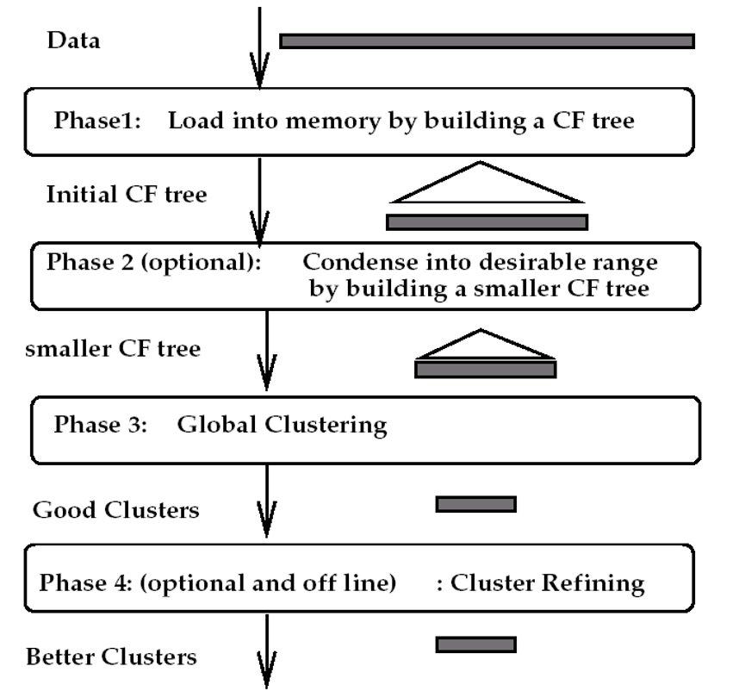

Slide 19
Example of BIRCH Clustering
X1 | X2 | X3 | X4 | X5 | X6 | X7
0.5 | 0.25 | 0 | 0.65 | 1 | 1.4 | 1.1
Threshold T= 0.15; no leaf may exceed 0.15 in radius. Number of entries in a leaf node L = 2 Branching factor B = 2; maximum number of child nodes for each non-leaf node.

Slide 20
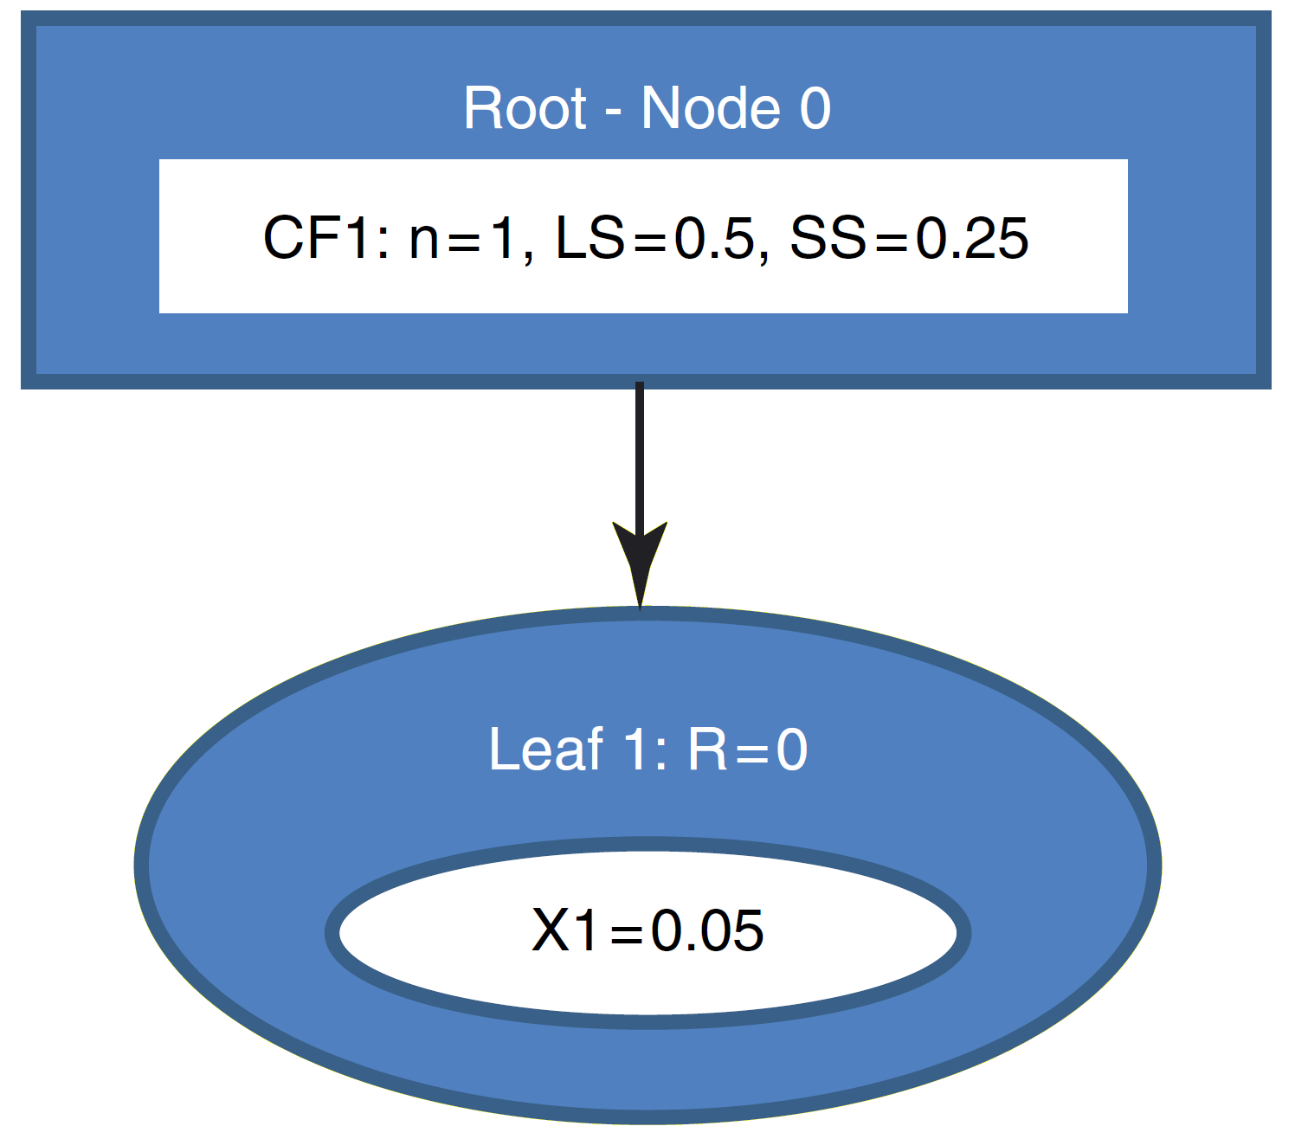
X1=0.05 enters, the root node is initialized with the CF values of X1. Leaf1 is created and X1 is assigned to Leaf1. since Leaf1 only has one record so radius of it is zero, and thus it is less than T=0.15.

Slide 21
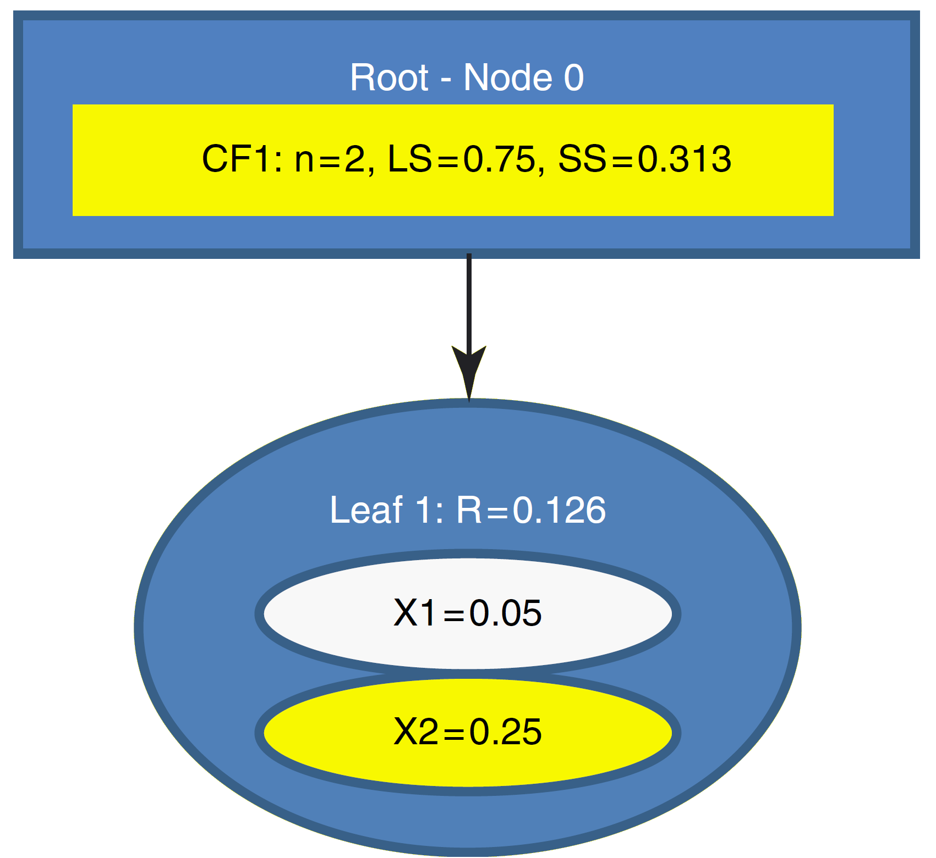
X2=0.25 enters, BIRCH passes X2 to leaf1, R(leaf1)=0.126 < T so X2 is assigned to leaf1. CF of parents are updated.

Slide 22
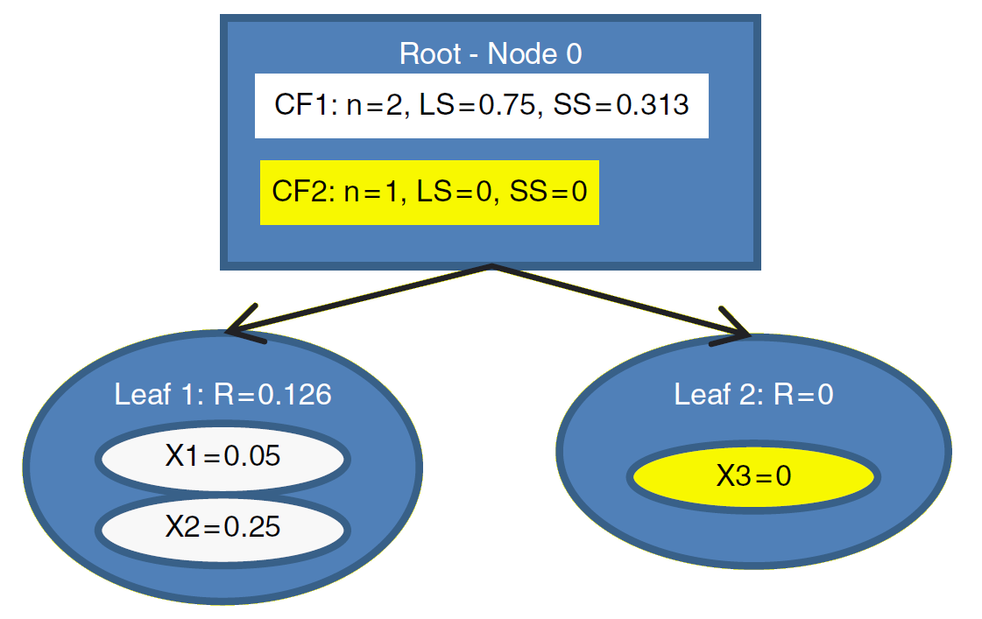
X3=0 enters, BIRCH tentatively passes X3 to leaf1. R(leaf1)= 0.205 > T so X3 is not assigned to leaf1. Instead, leaf2 is initialized, containing X3 only. CFs are updated.

Slide 23



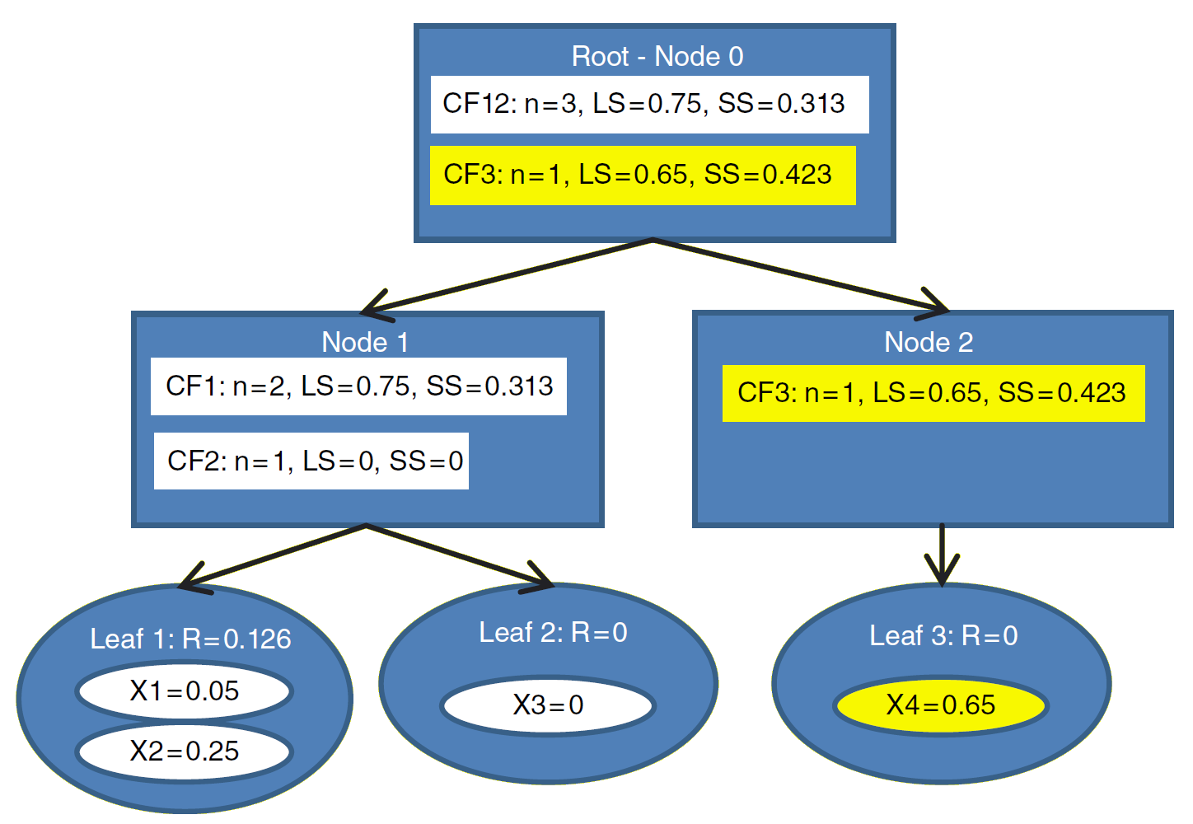
X4=0.65 enters, BIRCH compares X4 to centroids of CF1 and CF2 which is measured by . = 0.75/2 = 0.375 and = 0/1 = 0. X4 is closer to CF1 so it is passed to it. The R(CF1) = 0.166 > T so it is not assigned to it, Instead, BIRCH tries to create a new leaf but L = 2 meaning we can not have more that 2 leaves in a leaf node. So parent node is splitted and CFs are updated.

Slide 24

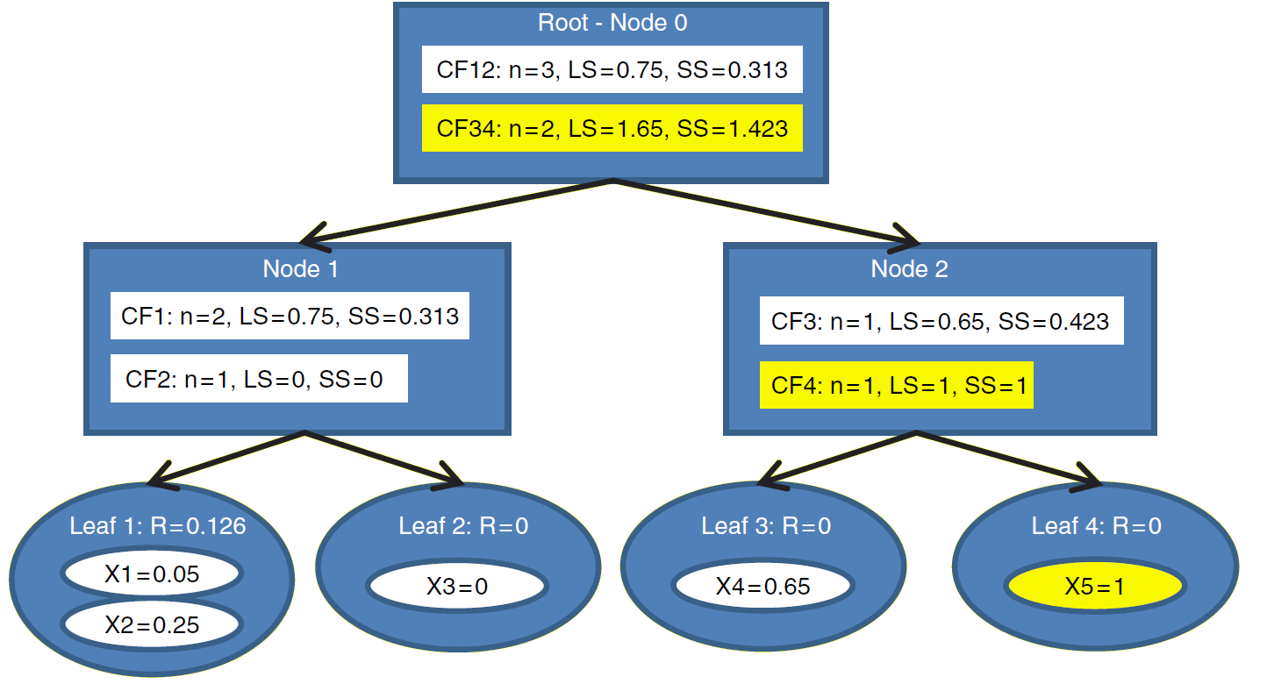
X5 enters, Birch compares centroid of CF12 and CF3 with x5. = 0.75/3 = 0.25 and CF3 = 0.65/1 = 0.65. X5= 1 is closer to CF3 then it is passed to CF3. R(CF3)= 0.175 > T. Instead, leaf 4 is initialized, with CF4 containing X5 only. CF values are updated.

Slide 25
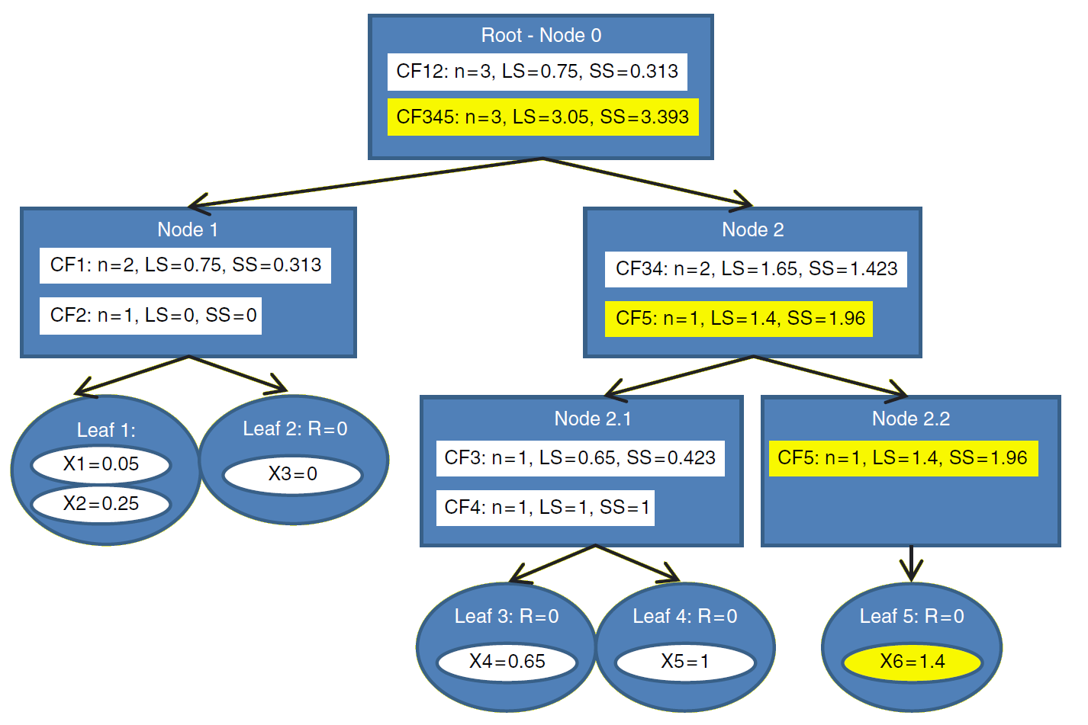
X6=1.4 enters, it is closer to CF34 centroid = 1.65/2 = 0.825, BIRCH passes X6 to CF34, descending to Node 2, again a centroid comparison, X6 is closer to CF4 = 1. Thus X6 is passed to CF4, R(leaf4) = 0.2 > T also L = 2 so another node is created.

Slide 26
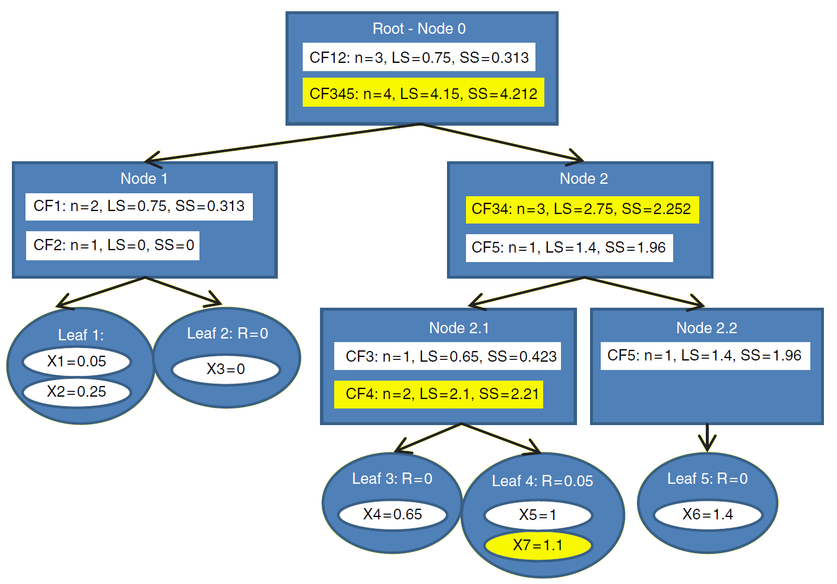
Finally, X7=1.1 enters. Centroid(C345)=1.02 Centroid(CF12)=0.25 so X7 is closer to C345. descending to Node 2, X7 is closer to CF34, down to Node2.1 X7 is closer to CF4 than CF3. so X7 is passed to CF4, R(leaf4) = 0.05 < T, thus X7 is assigned to leaf4.

Slide 27
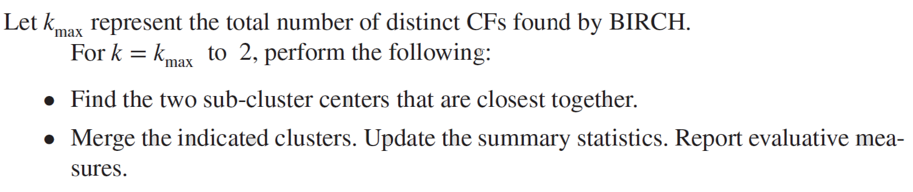
Phase 2: Agglomerative clustering of CFs
The cluster centers are as follows:
CF1 | CF2 | CF3 | CF4 | CF5
0.375 | 0 | 0.65 | 1.05 | 1.4
Starting with k=5 maybe this is the optimal clustering solution for this problem. So we form all K5 to K2 solutions to choose the best clustering based on a set of evaluative measures.

Slide 28
The two closest clusters are CF1 and CF3. Combining these CFs, we obtain a new cluster center of CF13 = (2x0.375 + 1x0.65)/3 = 0.47. The remaining clusters are
Now the two closest clusters are CF4 and CF5, combining these, we obtain another center CF45 = (2x1.05 + 1x1.4)/3 = 1.17.
Among these, CF2 and CF13 are closer, by combining these we obtain new center of CF123 = (2x0/374 + 1x0 + 1x0.65)/4 = 0.35.
So which one of these are the best clustering solution?
CF13 | CF2 | CF4 | CF5
0.47 | 0 | 1.05 | 1.4
CF13 | CF2 | CF45
0.47 | 0 | 1.17
CF123 | CF45
0.35 | 1.17

Slide 29
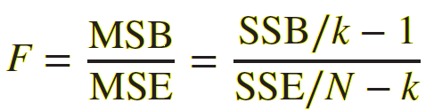
Evaluating the Candidate Cluster Solutions
One of the methods is the Pseudo-F Statistic
The Smallest P-value occurs when k=2
Value of K | MSB | MSE | Pseudo-F | P-Value
2 | 1.1433 | 0.3317 | 17.24 | 0.009
3 | 0.6533 | 0.0408 | 15.52 | 0.013
4 | 0.4628 | 0.0289 | 16.02 | 0.024
5 | 0.3597 | 0.0181 | 19.84 | 0.049

Slide 30
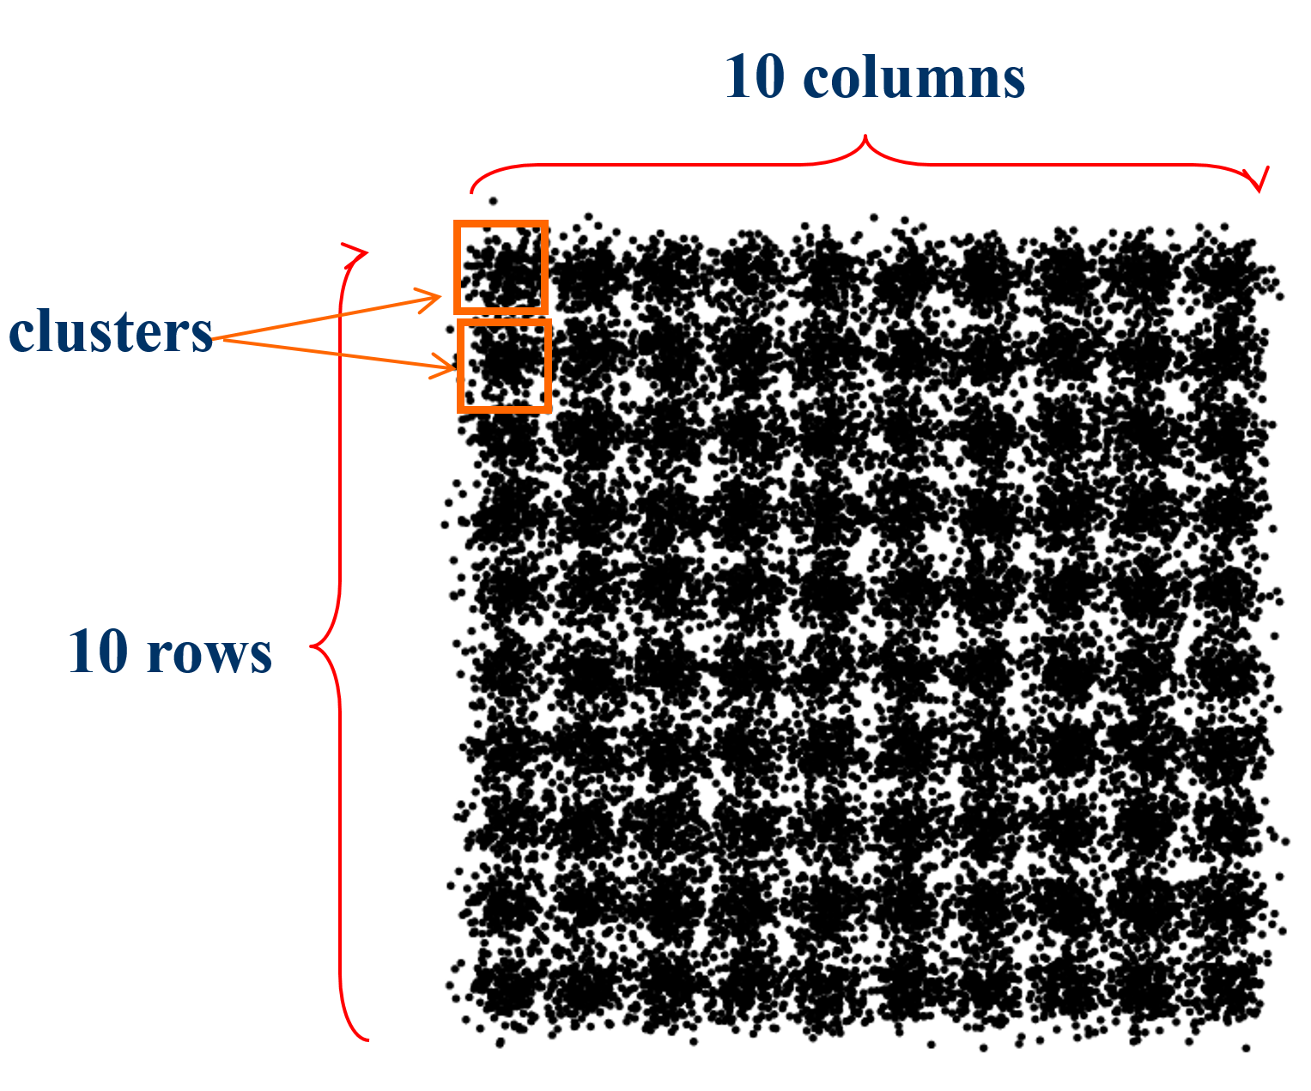
BIRCH vs CLARANS
Dataset:

Slide 31
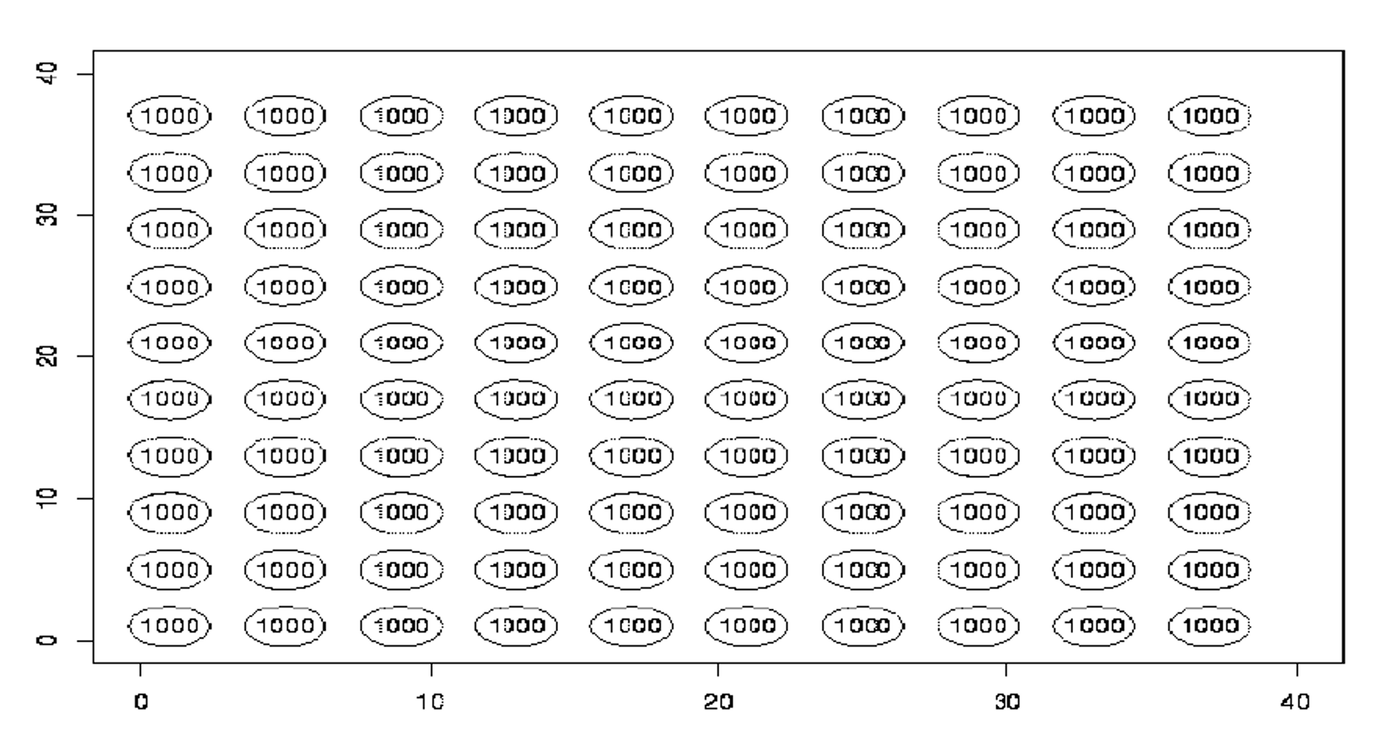
BIRCH vs CLARANS Actual Clusters of given datasets

Slide 32
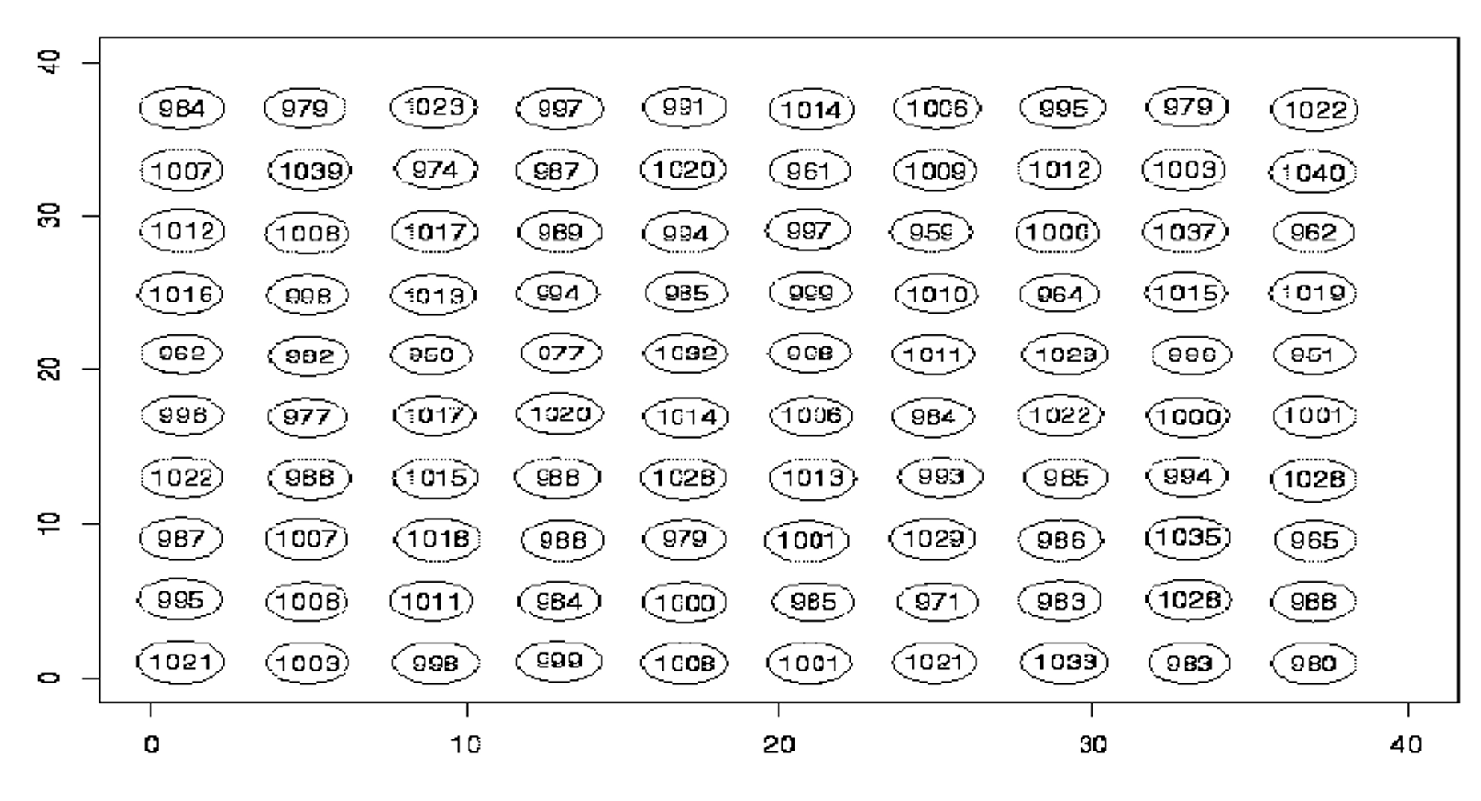
BIRCH vs CLARANS BIRCH Clustering Result

Slide 33
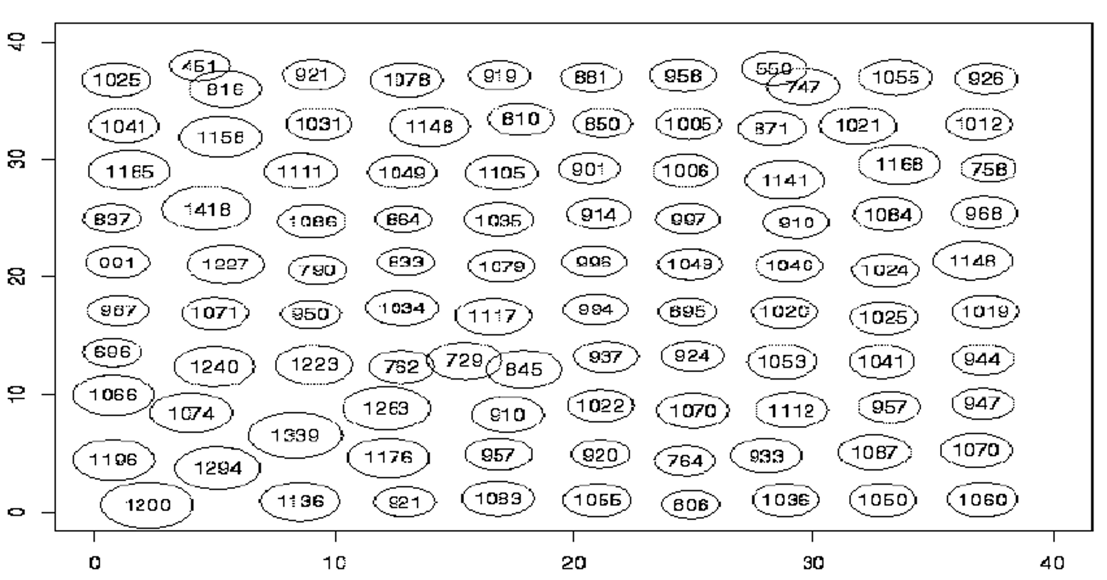
BIRCH vs CLARANS CLARANS Clustering Result

Slide 34
References
Wei Wang, Jiong Yang, and Richard R. Muntz. Sting: A statistical information grid approach to spatial data mining. In VLDB '97: Proceedings of the 23rd International
Sudipto Guha, Rajeev Rastogi, and Kyuseok Shim. Cure: an efficient clustering algorithm for large databases. In SIGMOD '98: Proceedings of the 1998 ACM SIGMOD international conference on Management of data, pages 73{84, New York, NY, USA, 1998. ACM.
Venkatesh Ganti, Raghu Ramakrishnan, Johannes Gehrke, and Allison Powell. Clustering large datasets in arbitrary metric spaces. In ICDE '99: Proceedings of the 15th International Conference on Data Engineering, page 502. IEEE Computer Society, 1999. (BUBBLE Algorithm)

Slide 35
References
Rakesh Agrawal, Johannes Gehrke, Dimitrios Gunopulos, and Prabhakar Raghavan. Automatic subspace clustering of high dimensional data for data mining applications. In SIGMOD 1998, Proceedings ACM SIGMOD International Conference on Management of Data, June 2-4, 1998, Seattle, Washington, USA, pages 94{105. ACM Press, 1998.
Andrew McCallum, Kamal Nigam, and Lyle H. Ungar. Ecient clustering of highdimensional data sets with application to reference matching. In KDD '00: Proceedings of the sixth ACM SIGKDD international conference on Knowledge discovery and data mining, pages 169{178, New York, NY, USA, 2000. ACM.
Cecilia M. Procopiuc, Michael Jones, Pankaj K. Agarwal, and T. M. Murali. A monte carlo algorithm for fast projective clustering. In SIGMOD '02: Proceedings of the 2002 ACM SIGMOD international conference on Management of data, pages 418{427, New York, NY, USA, 2002. ACM.

Slide 36
Thanks For Listening ^_^

